Slide 1
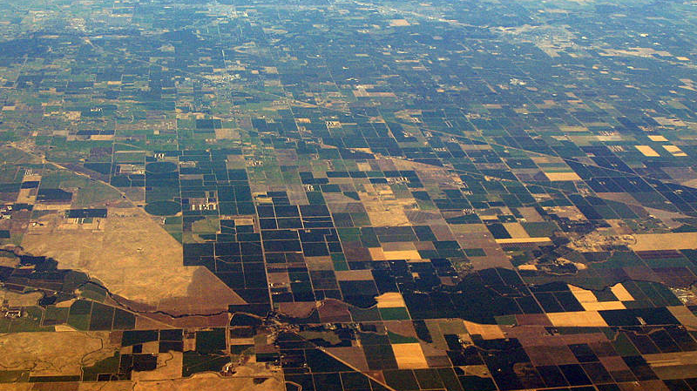
Valley Fever Environmental
Change this slide
Institutions, mentors, title
Felix, Le, Sanaa, Austin
Notes:
Speaker: Austin - Introduce our group
Hello everyone, I’m Austin
…
And today, we are the Valley Fever Environmental Group

Slide 2
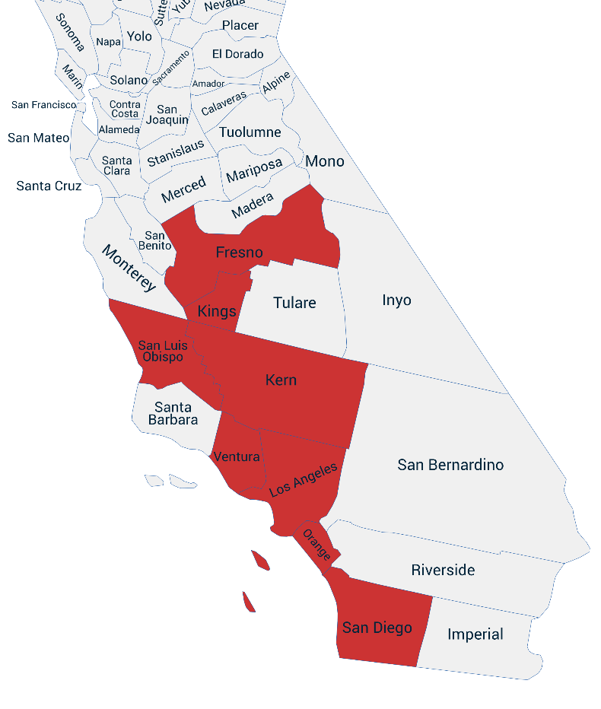
Background
Coccidioidomycosis
Data
An infectious respiratory disease endemic to the southwestern United States. It spreads when soil containing the fungus Coccidioides is disturbed and its spores are inhaled. Its symptoms are similar to the flu or COVID-19.
8 counties in CA
Monthly data, 2001-2024
Features:
Precipitation
Humidity
Wind Speed
Wind Run
Wind Event Count
Soil Temperature
Air Quality
Wildfires
Fungicide Usage
Rodenticide Usage
Target: Valley Fever case rates per 100k
Figure 1: The California counties included in our study, highlighted in red.
Notes:
Speaker: Austin - Explain VF background
To give some brief Background:
Valley Fever (scientific name: coccidioidomycosis) is an infectious respiratory disease endemic to the southwestern United States. It spreads when soil containing the fungus is disturbed and its spores are inhaled.
For our Data:
We focus on eight counties in California: Fresno, Kern, Los Angeles, Orange, San Diego, San Luis Obispo, Tulare and Ventura.
For each county we have monthly data, ranging from 2001-2024 on the following environmental variables:
Precipitation, Humidity, Wind Speed , Wind Run, Wind Event Count, Soil Temperature, Air Quality, Wildfires, Fungicide Usage, Rodenticide Usage
We use the Valley Fever case rates
per 100,000 residents as our target to predict.

Slide 3
Our Research
Questions We’re Answering
Why We Should Care
Which environmental factors are the strongest drivers of Valley Fever incidence?
Without the use of past case rates, can we effectively and accurately forecast Valley Fever outbreaks across counties before they occur?
Each year, approximately more than 20,000 VF cases are reported in the U.S., with the number only growing. While symptoms are usually only mild, a small portion of cases are severe, with some even resulting in death.
Through predictions we can anticipate outbreaks and case surges before they occur, allowing us to employ effective action and enact policy to help spread awareness of the disease.
Notes:
Speaker: Austin
So what are the questions we’re answering with our research ?
first,
Which environmental factors are the strongest drivers of Valley Fever incidence?
And
second,
Without the use of past case rates, can we effectively and accurately forecast Valley Fever outbreaks across counties before they occur?
and why we should care
Each year, approximately more than 20,000 VF cases are reported in the U.S., with the number only growing. While symptoms are usually mild/flu-like, a small portion of cases are severe, with some even resulting in death.
Through predictions we can anticipate outbreaks and case surges before they occur, allowing us to employ effective action and enact policy to help spread awareness of the disease.

Slide 4
Methodology
Talk about our data, we\ skipped it
County-by-county Models:
LSTM, LR
Aggregated Models:
LSTM, LR
Train On:
County Data
(Fresno-Ventura)
Aggregated Data
Test On:
County Data
(Fresno–Ventura)
Compare Metrics/Performance
Figure 2: Modeling pipeline comparing county-by-county and aggregated LSTM and linear regression models.
Notes:
Speaker: Austin
Methodology
For our research, we evaluated long short-term memory (LSTM) models and compared them with linear regression (LR) baselines. For both model types, we investigated two forecasting approaches:
First was
County-by-county: Each model was trained and tested using data from the same county.
And second was
Aggregated: Each model was trained on a monthly dataset created by aggregating the mean or median feature values across all eight counties, then evaluated separately on each county.
After training and testing,
We then compared the metrics and performances of each model.

Slide 5
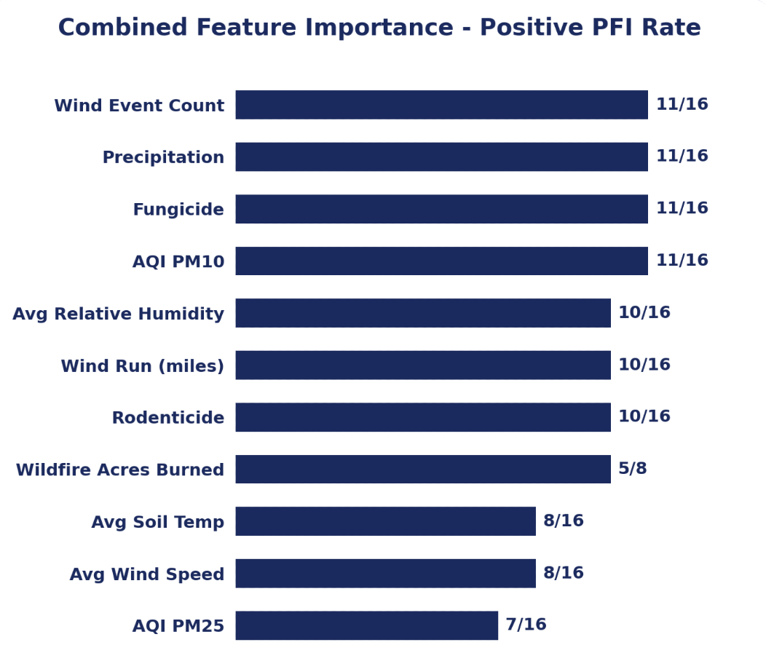
PFI on County by County models
Table/bar chart very confusing
Need x-axis
PFI niche enough that it’s worth explaining
Ran PFI on 8 CA counties, each with/without the fire variable - 16 total models
Most consistent predictors were wind eventcount, precipitation, fungicide and AQI_PM10
Wildfire Acres burned had importance in ⅝ models but only 2 showed significant improvement in modeling
AQI_PM25 was the weakest predictor in the table on showing for 7/16 searches
Figure 3: Frequency of positive permutation feature importance across county models (16 evaluations total; wildfire assessed in 8).
Notes:
Felix
Here also something that should be taken into consideration is that for the county of Tulare there is no wind events documented so the Importance is negative and in Kern and Ventura the wind events increase significantly at the end years of the dataset which could account for both those models marking windevent counts as negative on one of each of there models. Taking this into account the wind events seem to play a big role in valley fever rates which makes sense do to the nature of the disease. [PAUSE]

Slide 6
Most Important Features per County
County | First Highest | Second Highest | Third Highest
Fresno | Humidity | Soil Temperature | Wind Event Count
Tulare | Soil Temperature | Fungicide Usage | AQI PM25
Kern | Soil Temperature | AQI PM10 | Rodenticide Usage
Ventura | Fungicide Usage | AQI PM10 | Rodenticide Usage
Orange | AQI PM25 | Precipitation | AQI PM10
San Luis Obispo | Wildfire Acres Burned | Wind Event Count | Fungicide Usage
San Diego | Precipitation | Humidity | Rodenticide Usage
Los Angeles | AQI PM10 | Wind Event Count | Humidity
Should be a way to show the features/counties sequentially in a way that is easy to digest
Highlight some features (like soil temp) in Tulare Kern
Common features?
Sequential order
What these findings mean in a broader context (for early warning, we can predict using soil temperature in tulare and kern which is readily available)
It’s also hard to trust what we’re saying (like its not certain to audience how confidently they should believe that these are the best features, etc, more metrics)
Feature importance varied by county, supporting the use of county-specific feature selection.
Combined view hides county-level variation, feature importance isn't uniform across the state
Inland (Central Valley): Kern and Tulare rely heavily on soil temperature
Coastal/Southern: Orange, San Diego, and LA are driven more by AQI and precipitation
Wind event count, one of the strongest overall predictors still shows up almost everywhere, but usually as the 2nd or 3rd feature rather than the top one
Notes:
Felix

Slide 7
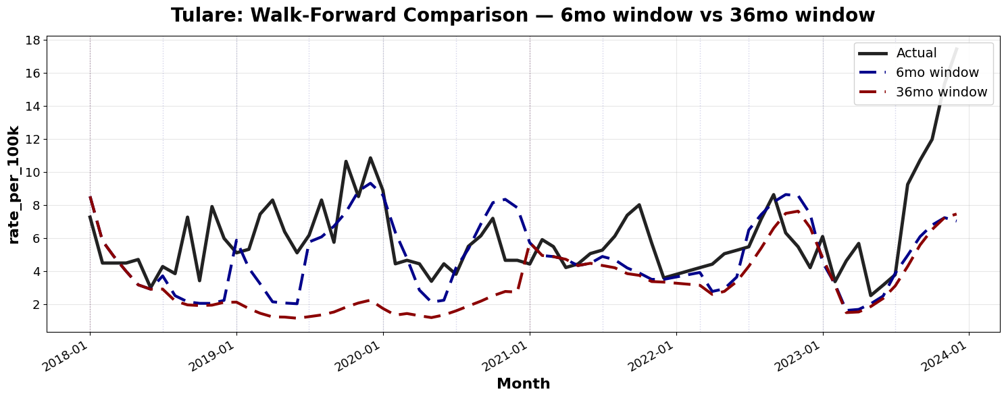
Training Window Comparison
6 month and 36 month jump is drastic
Perhaps explain why we do such a big jump
3, 6, 12, 36 month
Conclusion about we dont rlly need to predict 3 years in advance makes sense
Figure 4: Observed and predicted Valley Fever rates for Tulare county using walk-forward LSTM models with 6-month and 36-month training windows.
Notes:
Felix

Slide 8
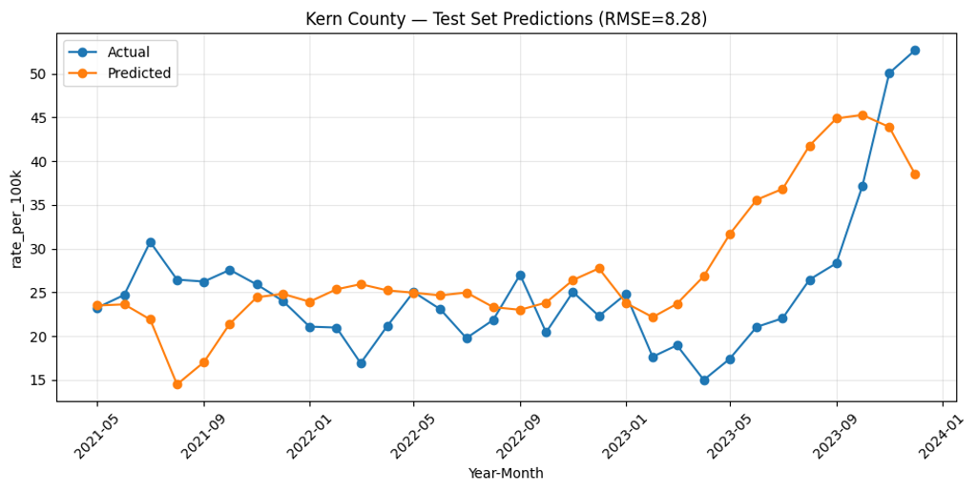
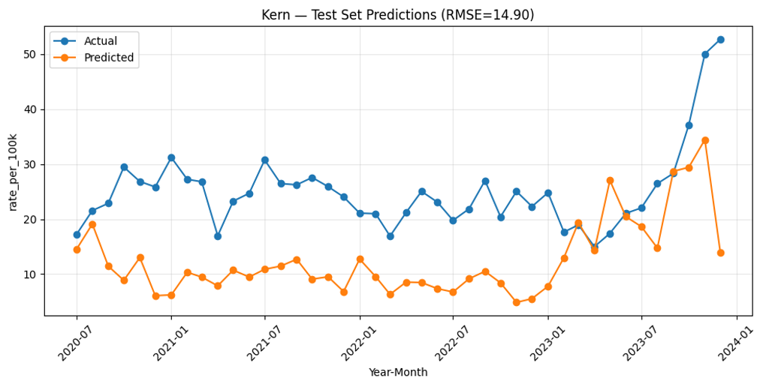
Results
County | Linear Regression RMSE | Aggregate LSTM RMSE | County-by-county LSTM RMSE
Fresno | 2.737 | 4.276 | 1.607
Tulare | 5.573 | 3.995 | 3.098
Kern | 20.168 | 24.724 | 11.201
Ventura | 1.853 | 3.714 | 1.967
Orange | 0.234 | 2.914 | 0.276
San Luis Obispo | 7.141 | 7.316 | 4.074
San Diego | 0.384 | 2.137 | 0.558
Los Angeles | 0.214 | 2.626 | 0.309
Conclusion about not trusting just RMSE for model performance, but how the predictions actually look makes sense
A lot of questions about what “qualitatively better” means
Perhaps another way to present table and following graph
LSTMs capture dynamics LR misses
Although linear regression models achieved competitive RMSEs, the county-by-county LSTMs showed much stronger qualitative performance
LA, Orange and San Diego counties were difficult for the LSTM in general
County-by-county LSTMs outperformed the aggregated LSTM
Model without fire:
Notes:
Speaker: Sanaa
This table compares linear regression, the aggregate LSTM, and CBC LSTMs using RMSE scores
Although linear regression models achieved lower RMSEs, the county-by-county LSTMs showed much stronger qualitative performance capturing trends better
linear regression performed best in Ventura, Orange, San Diego, and Los Angeles. Which were difficult counties for the LSTM’s in general
The county-level LSTM outperformed the aggregate LSTM in all eight counties, showing that a single model trained on aggregated data does not capture county specific disease trends

Slide 9
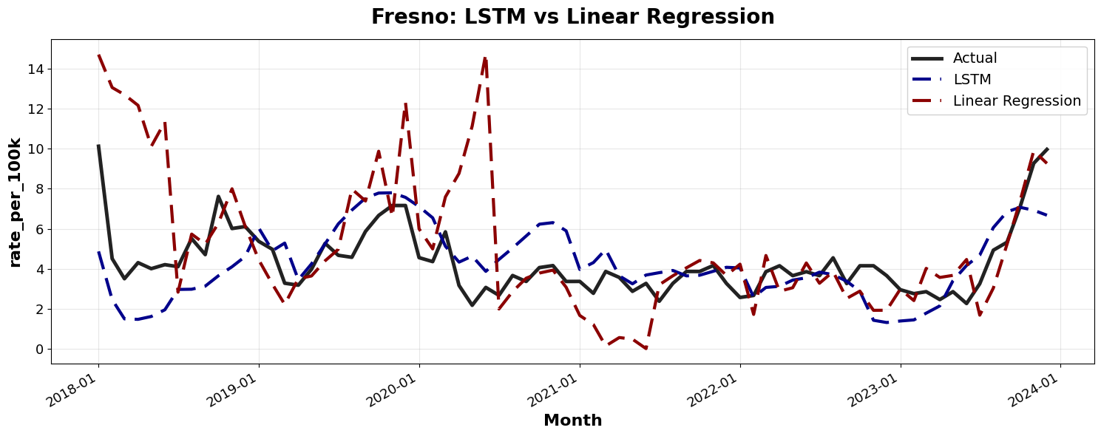
Model Comparison
I think graphs could look better (lines are hard to see, austin)
Figure 5: Observed and predicted Valley Fever rates for Fresno county using LSTM and linear regression models.
Notes:
Sanaa LSTMs capture dynamics LR misses the county-by-county LSTMs showed much stronger qualitative performance capturing trends better

Slide 10
Conclusions
The importance of features varied by county, supporting the use of county-specific feature selection.
Wind events, precipitation, fungicide use and AQI PM10 were the most influential features
Our conclusions are more like extensions of our results
They should be more broad!!!
Talk about what they mean in the real world, we did a lot of great things but we should highlight more of why what we’ve done is important (social impact)
County-by-county LSTMs demonstrated strong qualitative performance, better capturing seasonality, temporal variations and dips/peaks in the Valley Fever rates
County-specific training also better conserves local patterns over aggregate-trained LSTMs
Shorter training windows were better at capturing micro trends
Notes:
Speaker: Le
The importance of features varied by county, supporting the use of county-specific feature selection.
Wind events, precipitation, fungicide use and AQI PM10 were among the most consistently influential features.
Although LR models achieved competitive RMSEs, the county-by-county LSTMs demonstrated much stronger qualitative performance, better capturing seasonality, temporal variations and dips/peaks in the Valley Fever rates.
The county-by-county LSTMs also generally outperformed the aggregated LSTMs, suggesting that county-specific training better conserves local patterns.
Shorter training windows were more responsive to recent changes, while longer windows produced smoother forecasts.

Slide 11
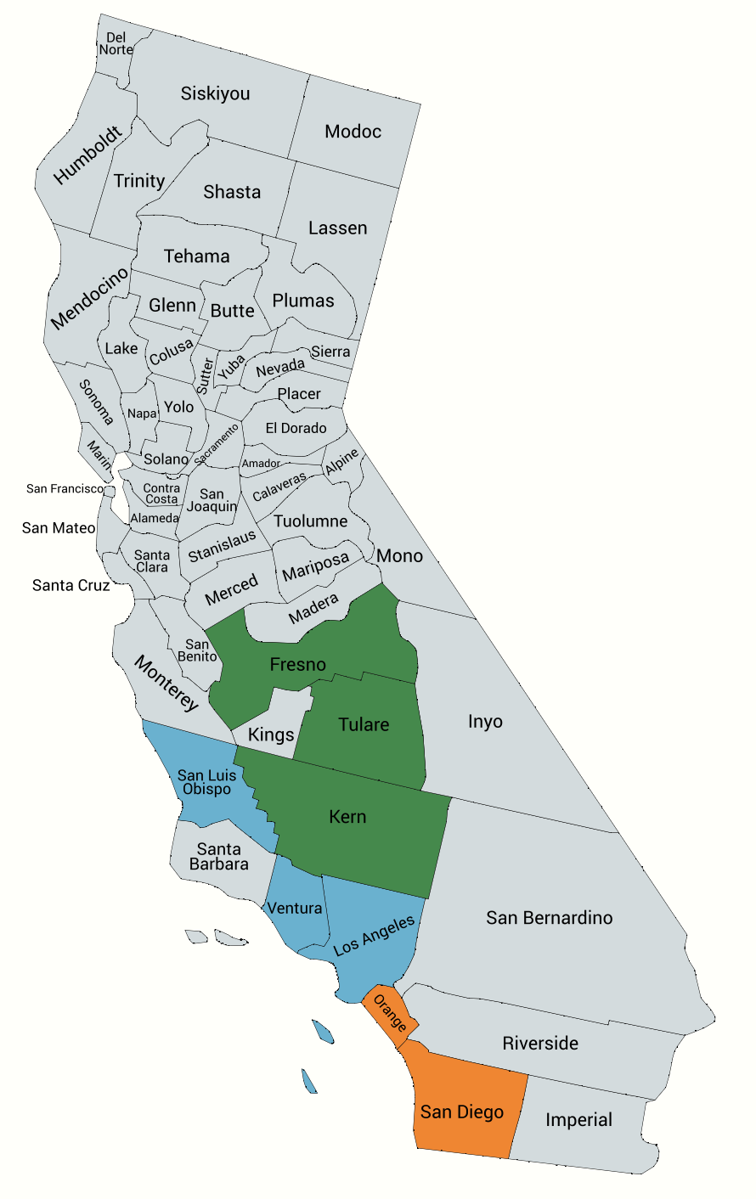
Future Work
Possibly discuss why is imputing the missing fire data important?
Create aggregate data using all counties
Group counties into 3 regions:
inland, lower coast, and upper coast
Independent lags for different features
Impute or acquire the missing fire data
Figure 6: Possible regional groupies of California counties: inland (green), upper coast (blue), lower coast (orange)
Notes:
Speaker Le
For our future work:
Train the aggregate models using data from all California counties rather than only eight.
Group counties into three geographic regions: inland, lower coast, and upper coast.
Apply feature-specific lags to capture delayed effects.
Impute or find missing fire data.

Slide 12
Thank You
Notes:
Le

